Slide 1
POWER BI ASSIGNMENT PRESENTATION
GROUP 2
OLARONKE ADEGBITE
ADEIFE ADELEYE
KINDNESS ALOZIE

Slide 2
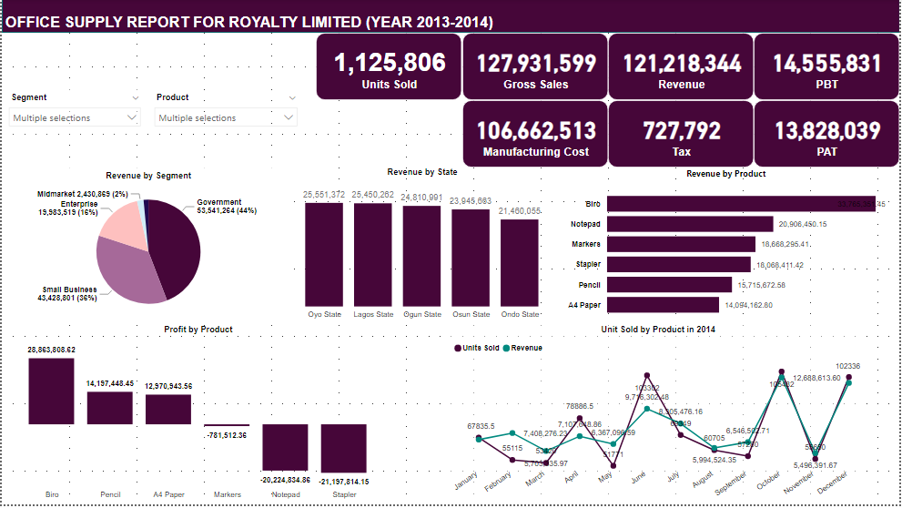
EXECUTIVE SUMMARY

Slide 3
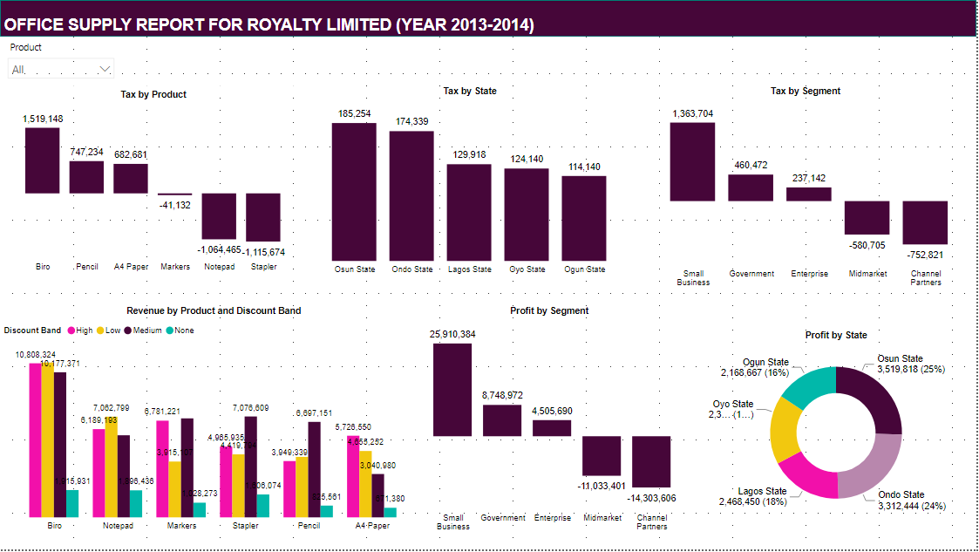
EXECUTIVE SUMMARY

Slide 4
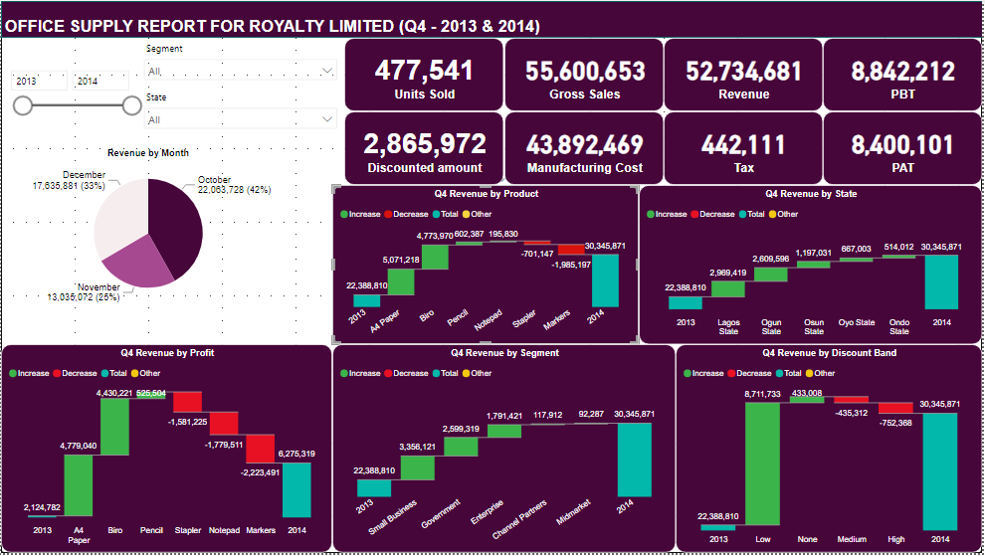
EXECUTIVE SUMMARY

Slide 5
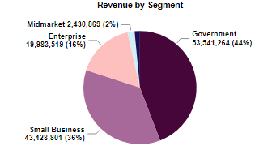
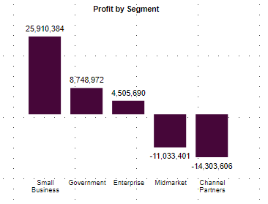
KEY FINDINGS
Customers were sectioned into four categories/segments out of which Government category contributed majorly to revenue for the period under review. “Government” had a total revenue of N53,541,264 contributing 44% of the total revenue. The least category was “Channel Partners” with a total revenue of N1,833,890.46 contributing 1.51% of the total revenue.
In terms of profit, “Small Business category” led the way with a total Profit After Tax (PAT) of N25,910,384 representing 66% of the total profit for the period under review. “Mid Market” and “Channel Partners” categories experienced a negative PAT of –N11,033,401 and –N14,303,606 respectively.

Slide 6
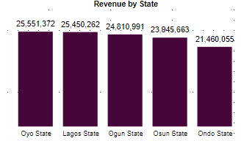
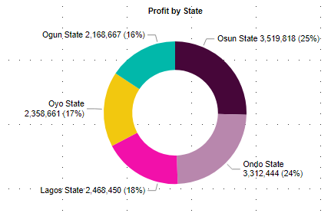
KEY FINDINGS
For the states analyzed, “Oyo State” was the highest performing state with a revenue of N25,551,372 while “Ondo State” was the least performing state with a total revenue of N21,460,055.
In terms of profit, “Osun State” led the way with a PAT of N3,519,818 while “Ogun State” made a PAT of N2,168,667 this can be attributed to the various manufacturing cost in each state.

Slide 7
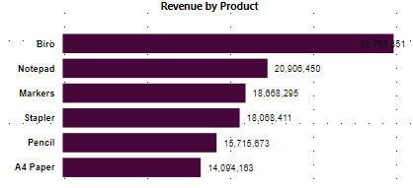
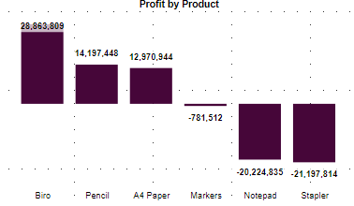
KEY FINDINGS
Looking at the revenue generated by each product for the period under review, the top performing product was “Biro”, with a revenue of N33,765,351 While the least product was “A4 paper” with a total revenue of N14,094,163.
In terms of profit by product, “Biro” led the way with a total Profit After Tax (PAT) of N28,863,809 representing 52% of the total profit for the period under review. “Notepad” and “Stapler” experienced a negative PAT of –N20,224,835 and –N21,197, 814 respectively.

Slide 8
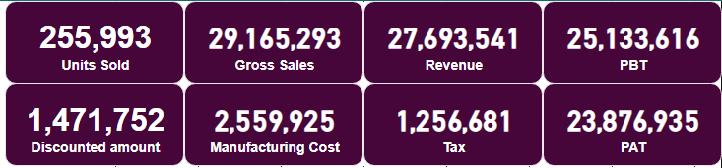
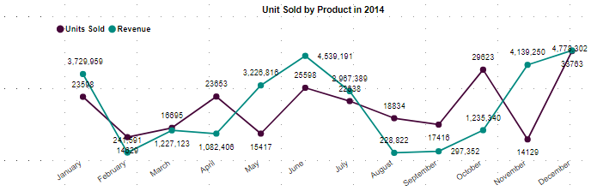
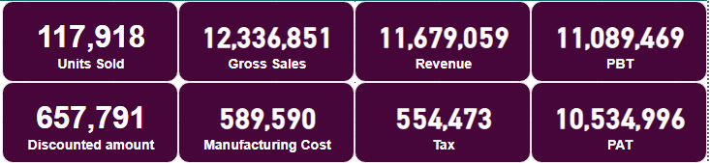
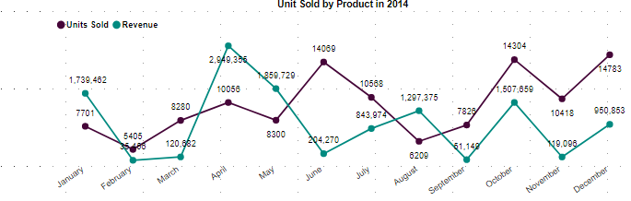
SALES ANALYSIS FOR EACH PRODUCT IN 2014
BIRO
PENCIL

Slide 9
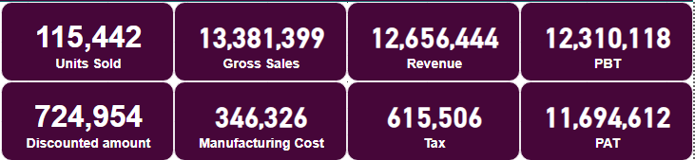
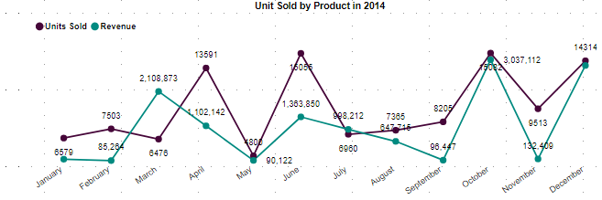
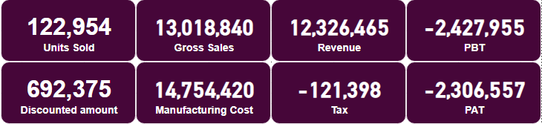
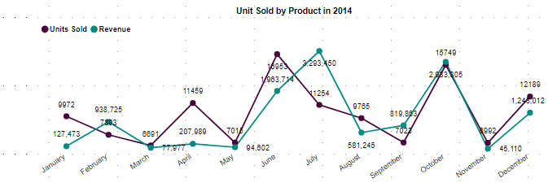
SALES ANALYSIS FOR EACH PRODUCT IN 2014
A4 PAPER
MARKERS

Slide 10
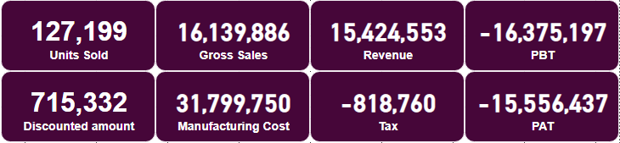
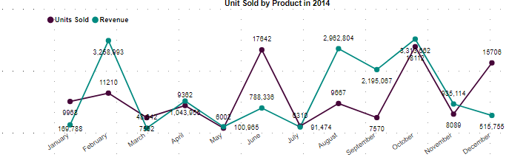
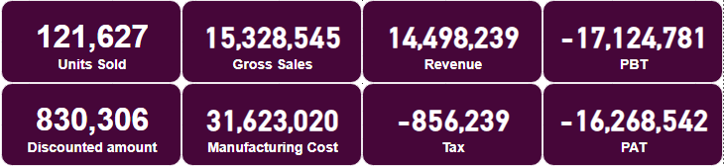
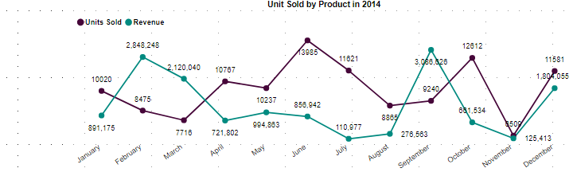
SALES ANALYSIS FOR EACH PRODUCT IN 2014
NOTEPAD
STAPLER

Slide 11
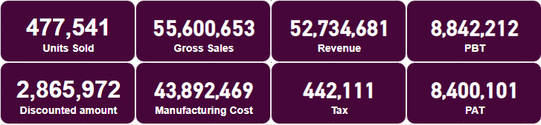
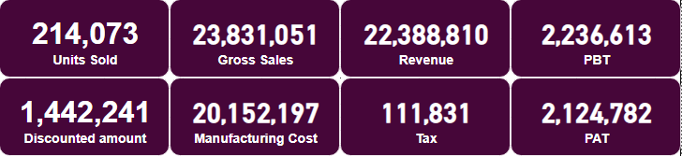
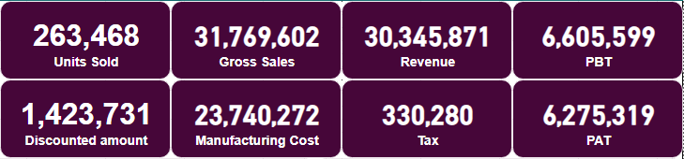
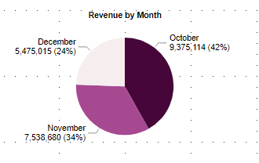
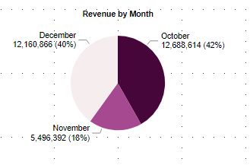
2013 Q4 VS 2014 Q4
Overall Financial Position
2013 Q4 FINANCIAL POSITION
2014 Q4 FINANCIAL POSITION

Slide 12
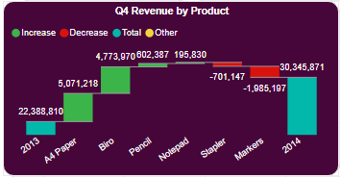
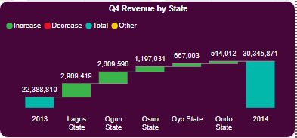
2013 Q4 VS 2014 Q4
Comparing both 2013 and 2014 QA performances, in terms of revenue, “A4 paper”, and “Biro” accounted for the majority of the increase among products with a percentage increase of 524% and 89% respectively, while “Stapler” and “Markers” experienced a decrease in sales. The relative contribution made by “A4 paper”, “Biro” and “Markers” changed the most.
In terms of State performances, “Lagos State”, “Ogun State” and “Osun State” accounted for the majority of the increase amongst the states.

Slide 13
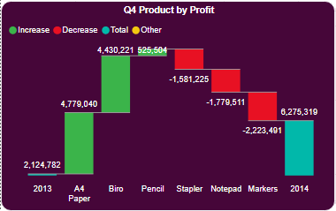
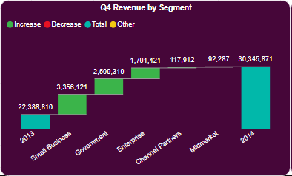
2013 Q4 VS 2014 Q4
Looking at PAT recorded by each products, “A4 paper, “Biro” and “Pencil” experience a positive growth between both periods while “Stapler”, “Notepad” and “Markers” had a negative PAT which can be majorly attributed to high cost of production.
Each customer segment experienced a positive increase. “Small Business”, “Government” and “Enterprise” accounted for the majority of the increase.

Slide 14
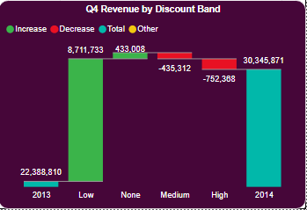
2013 Q4 VS 2014 Q4
In terms of revenue generated by each discount band, “Low band” accounted for the majority of the increase amongst the bands with 165% percentage increase.

Slide 15
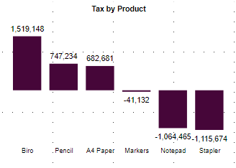
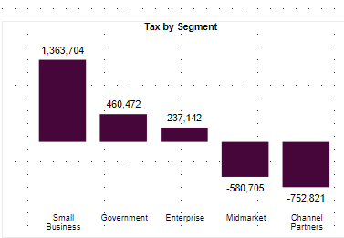
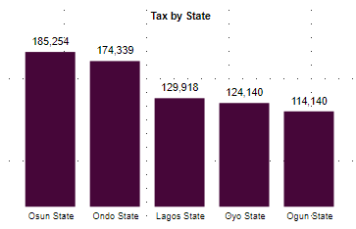
TAX ANALYSIS
In terms of tax, overall tax was being paid more on “Biro”, because they generate the highest revenue for the company.
for customer segment, more tax was being paid on “Small Business”.
On the state level, more tax was being paid by “Osun State” compared to other states

Slide 16
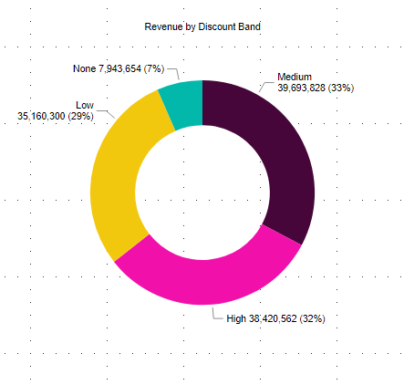
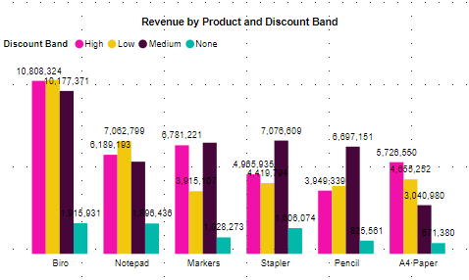
DISCOUNT BAND ANALYSIS
Looking at the revenue recorded by each discount band, “Medium” and “High” discount bands contributed maximally to the revenue for the period under review, with a percentage contribution of 33% and 32% respectively. This shows that the company experienced more sales when there are discount on their products.
This analysis shows that there is more sales when there are discount on products. However, the result for each discount band varies per product.

Slide 17
RECOMMENDATIONS
The key products that were the drivers of performance are “Biro”, “Pencil” and “A4 paper”.
We suggest that the company discontinue the production of stapler due to its high cost of production. Also, the product performance increased only when there was a medium or high discount on the product. The product also experienced a negative PAT year upon year.
Generally, Royalty limited needs to work on their manufacturing cost. We will advise they source for their raw materials locally so as to reduce the manufacturing cost because this is the major cost affecting their profit.
In terms of promos/discount, the low discount band should be more encouraged in order to improve the profit of the organization.

Slide 18
CONCLUSION
In conclusion, the period under review was a good year for Royalty Limited with a PAT of N13.8million. The company needs to work on reducing the manufacturing cost for all products, in order to have higher profits in coming years.

Slide 19
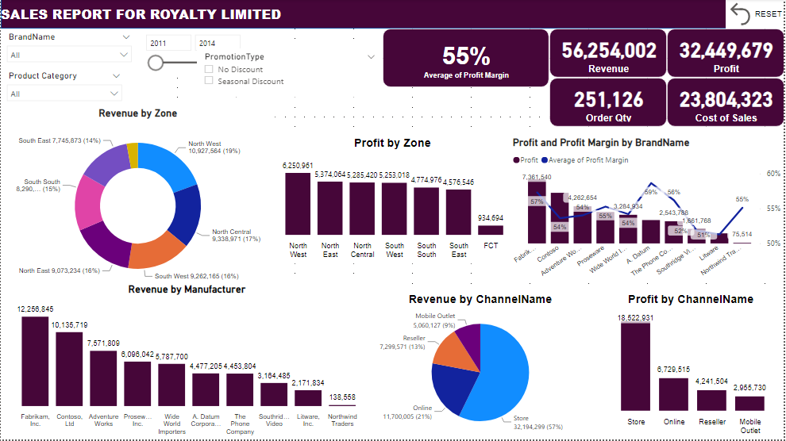
EXECUTIVE SUMMARY

Slide 20
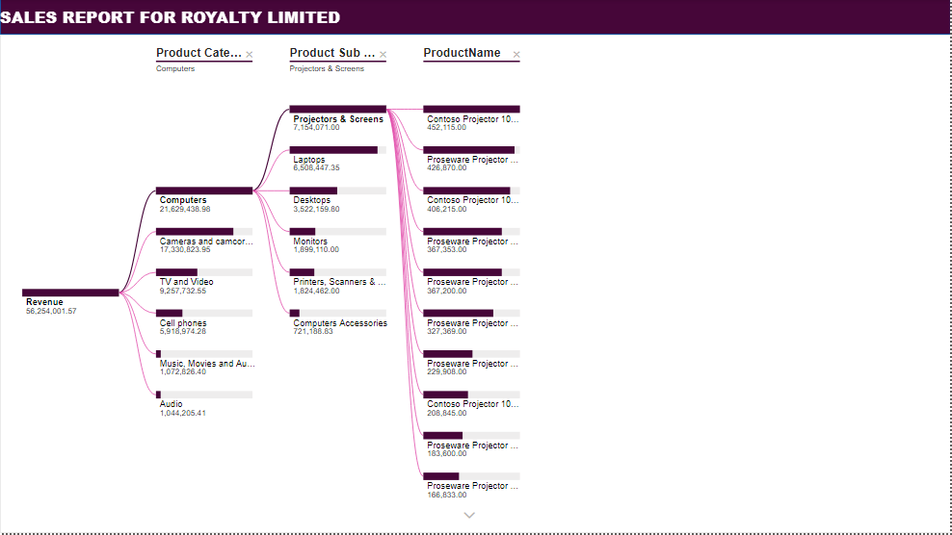
EXECUTIVE SUMMARY

Slide 21
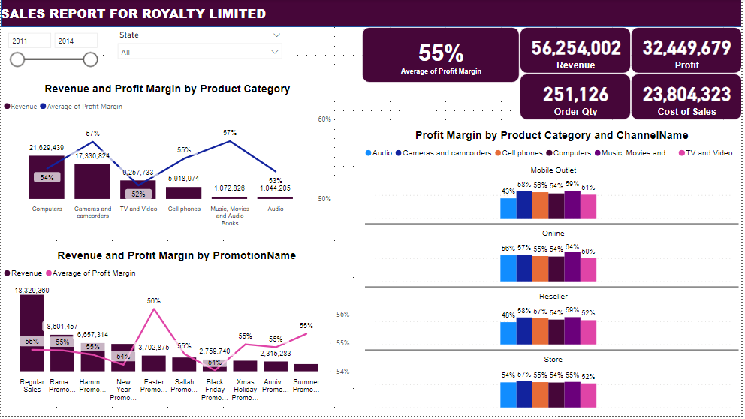
EXECUTIVE SUMMARY

Slide 22
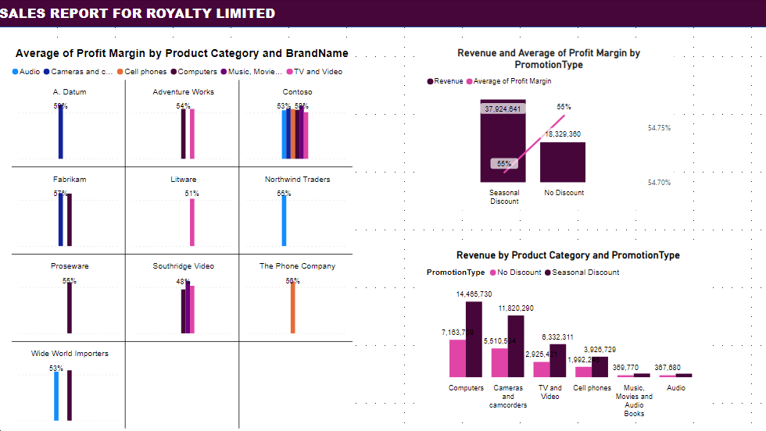
EXECUTIVE SUMMARY

Slide 23
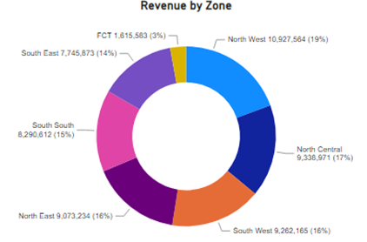
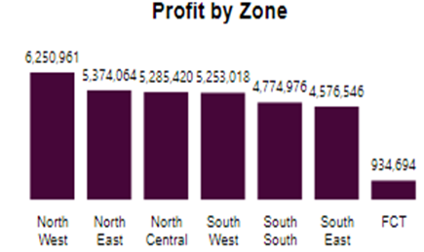
KEY FINDINGS
Based on the revenue recorded by the six geo-political zones in the country, “North West” contributed majorly to revenue for the period under review. “North West” had a total revenue of N10,927,564 contributing 19% of the total revenue. The least zone was “FCT” with a total revenue of N1,615,583 contributing 3% of the total revenue.
In terms of profit, “North West” led the way with a total Profit After Tax (PAT) of N6,250,961 representing 19% of the total profit for the period under review.

Slide 24
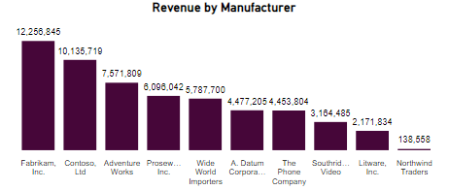
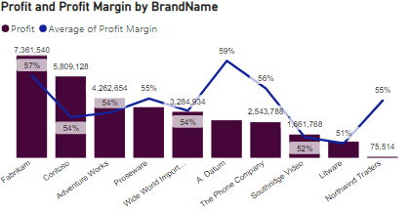
KEY FINDINGS
For the revenue contribution by each manufacturer, “Fabrikam” was the highest performing manufacturer with a revenue of N12,256,845 while “Northwind Traders” was the least performing Manufacturer with a total revenue of N138,558.
In terms of profit, “Fabrikam” led the way with a PAT of N7,361,540 while “Northwind Traders” made a PAT of N75,514. Looking at the profit margin, “A. Datum” recorded the highest profit margin with a profit margin of 59% while “Litware” had the least profit margin with a profit margin of 51%.

Slide 25
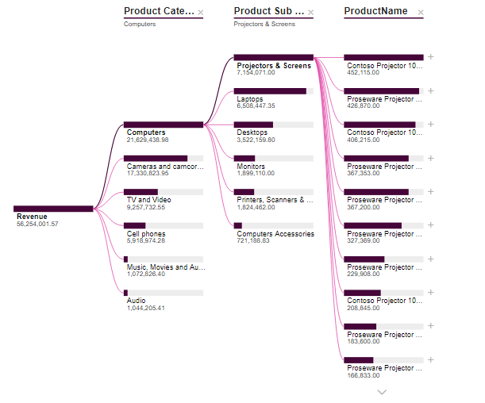
KEY FINDINGS
Product Category by Revenue
Looking at the hierarchy tree, the most performing product category in terms of revenue was “Computers” with a total revenue of N21,629,438.98.

Slide 26
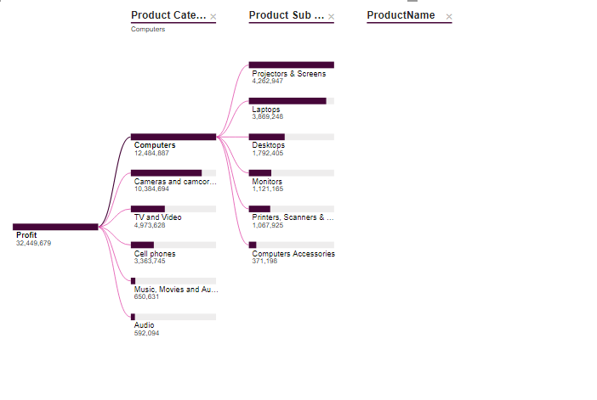
KEY FINDINGS
Product Category by Profit
For the profit made by each product category, “Computers” recorded the highest profit with a profit of N12,484,887 and “Audio” recorded the lowest profit with a profit of N592,094.

Slide 27
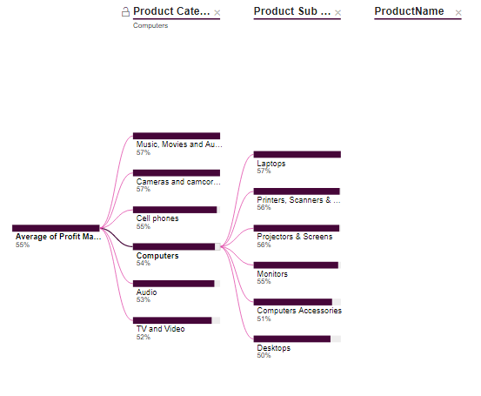
KEY FINDINGS
Product Category by Profit Margin
For the profit margin made by each product category, “Camera” and “Music, Movies and Audio Books” recorded the highest profit margin with a profit margin of 57% and “TV and Video” recorded the lowest profit margin with a profit margin of 52%.

Slide 28
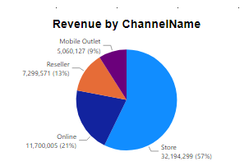
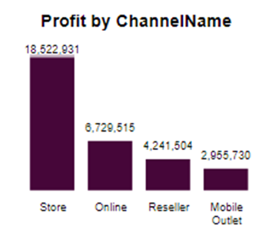
KEY FINDINGS
For the revenue contribution by each sales channel, sales from “Store” recorded the highest revenue with a total revenue of N32,194,299 representing 57% of the total revenue. The least performing sales channel was “Mobile outlet” with a total revenue of N5,060,127 which represents 9% of the total revenue.
In terms of profit, “Store” led the way with a PAT of N18,522,931 while “Mobile Outlet” made a PAT of N2,955,730.

Slide 29
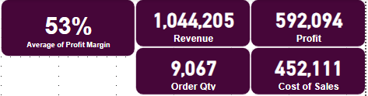



SALES ANALYSIS FOR EACH PRODUCT CATEGORY
AUDIO
CAMERAS AND CAMCODERS

Slide 30




SALES ANALYSIS FOR EACH PRODUCT CATEGORY
CELL PHONES
COMPUTERS

Slide 31




SALES ANALYSIS FOR EACH PRODUCT CATEGORY
MUSIC, MOVIES AND AUDIO BOOKS
TV AND VIDEO

Slide 32


PRODUCT PROMOTION ANALYSIS
Based on the analysis carried out for the revenue performance for the different types of promotions applied , “Regular Sales” generated the highest revenue while “Easter promotion” had the highest profit margin with a profit margin of 56%.
Looking at the promotion type analysis for the period under review, the “Seasonal Discount” yielded better result across all products compared to “No Discount”

Slide 33

PRODUCT PROMOTION ANALYSIS
In comparing the effect of the “Promotion name” on each product, we can see that “Regular Sales” gave better result compared to others, across all products.

Slide 34



PROFIT MARGIN ANALYSIS
In terms of Overall profit margin, “Cameras and camcorders” and “Music, Movies and Audio Books” had the overall profit margin with an average profit margin of 57% for the period under review.

Slide 35



PROFIT MARGIN ANALYSIS

Slide 36
RECOMMENDATIONS
The key products that were the drivers of performance are “Computers”, and “Cameras and Camcorders”.
All products performed well during the course of the year. However, if there will be a need to discontinue any product it will be “TV and Video”. This is because of its low profit margin (52%) and its cost – to – revenue ratio (46%), which is the highest among the product categories.
In terms of promos/discount, the seasonal discount promo should be more encouraged in order to improve the profit of the organization.

Slide 37
CONCLUSION
In conclusion, the period under review was a good year for Royalty Limited with a PAT of N32.4million. The company needs to work on reducing their cost – to – revenue ratio in order to have higher profit in the coming year.

